Slide 1
Luxury Big Island
Facebook Ad Summary - 2017

Slide 2
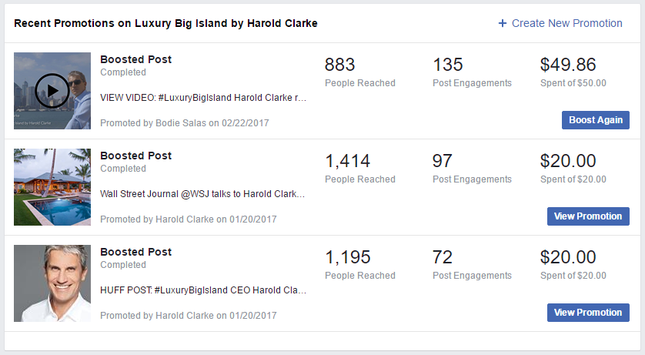


Promotion Summary
3 Facebook promotions were done by boosting posts directly from the page.
4th Facebook promotion was created using Facebook ad manager instead of directly boosting the post through the page. A better technique.

Slide 3
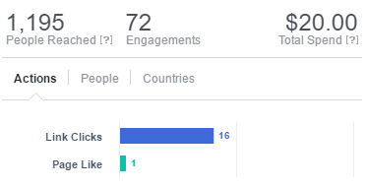

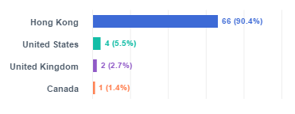
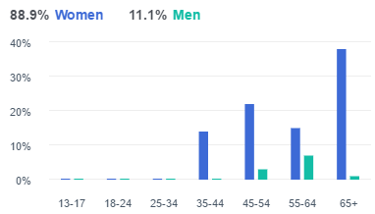
Huffington Post
Post reach was primarily women in Hong Kong
Post was aided by the source of the article
Post image may be factor in engagement demographic

Slide 4
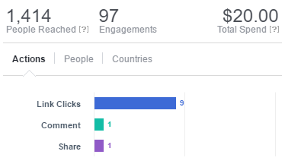

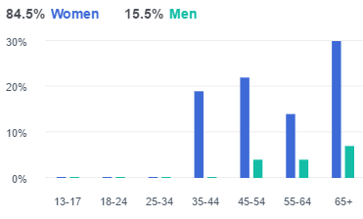
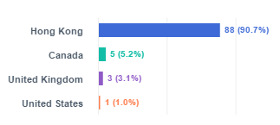
WSJ
Post reach was primarily women in Hong Kong
Post was aided by the source of the article (WSJ)

Slide 5
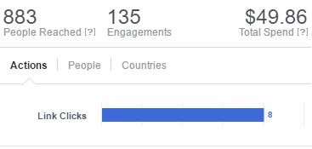

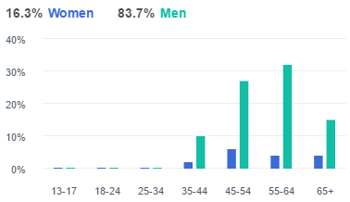
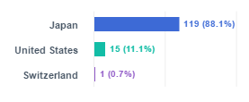
Video
Post reach was primarily men in Japan
Post was for a website link and not a video uploaded to Facebook
Two campaigns executed $50 (indicated here) and $200 (next pages)

Slide 6
Boost Limitations
Page boosting allows us to quickly boost posts and make rudimentary targeting but targeting options are limited
01
Difficult to make targeting changes when promotions are running
02

Slide 7
Ad Manager
4th promotion ($200 budget) was created using Facebook ad manager
1
Ad manager gives advertisers more control with how to target and where to show ads
2
Running campaigns be updated quickly in response to real time reports
3

Slide 8
Current Running Ad
Promoting the video content
1
Goal is to promote the post to an audience in the West Coast of the United States
2
Created custom audience which can be reused for similar campaigns in the future
3
Allows advertiser to specify platforms and devices to use for displaying ads
4

Slide 9
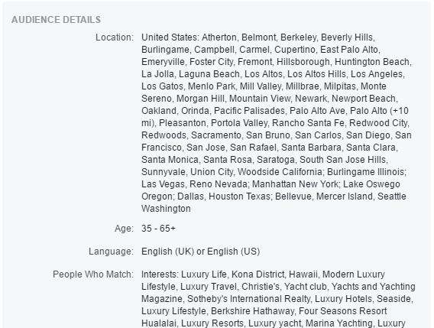
Audience Details
Targeted based on city, age, language and narrow interests
Avoided broad interest groups to ensure focused delivery

Slide 10
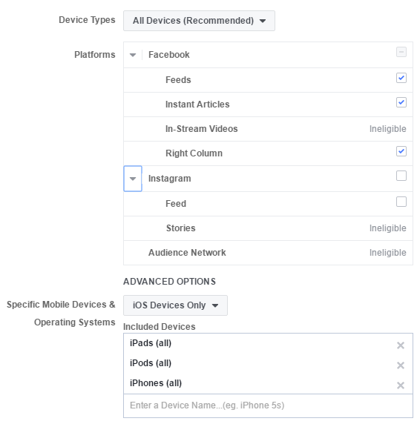
Device and Platform Targetting
Targeting Facebook only. No Instagram and no ads on the audience network.
Initially launched targeting all mobile devices. Changes were made to target only iOS devices in the latter half of the promotion.

Slide 11
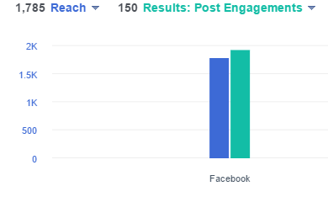
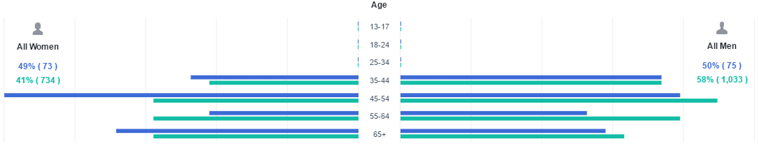
Demographics
Ad showed on more even demographic. Audience no longer skewed towards a specific gender.

Slide 12
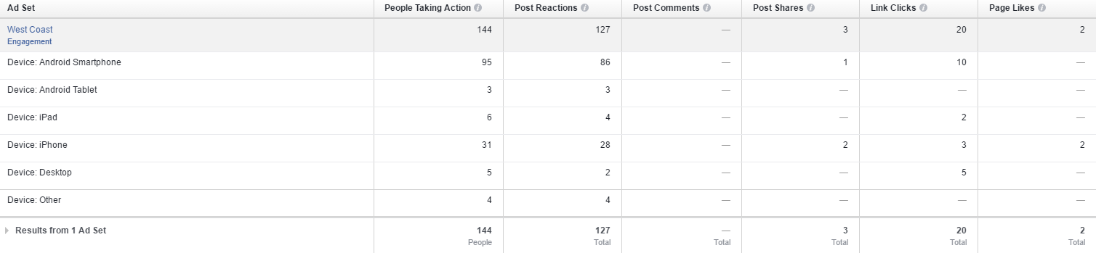
Performance by Device
Post generated many reactions from android devices.

Slide 13
Post Reach

Slide 14
Activity by Location
Most of the current activities for the promotion are from California or Texas.
Region | People Taking Action | Post Reactions | Post Shares | Link Clicks | Page Likes
California | 66 | 59 | 1 | 9 | 1
Texas | 64 | 57 | 2 | 7 | 1
Nevada | 9 | 8 |  | 1
Washington | 5 | 3 |  | 3

Slide 15
Suggestions for Future Campaigns
Host videos on Facebook to improve performance and to take advantage of additional features and metrics (work on getting more videos online)
Continue targeting specific audiences
Track site activity by taking advantage of Facebook pixels
Consider raising daily spend to increase reach

