Slide 1
Luxurybigisland.com PPC Review
February 2017

Slide 2
Impressions and clicks
Removed low performing KWs to improve quality score

Slide 3
Impressions and clicks activity
CTR improved by 137% compared to January 2017.
1
Improved campaign efficiency due to better keyword bidding, targeting, and aggressive keyword monitoring. Average daily impressions decreased but daily clicks increased by 24.6%.
2
Differentiating between luxury and other non real estate traffic continues to be the focus for optimization.
3

Slide 4
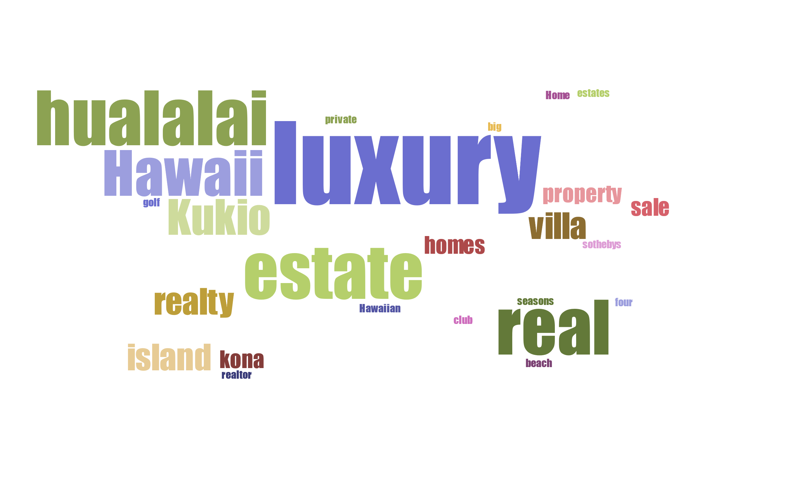
Keywords
Aggressive negative keyword monitoring to remove unrelated search terms and prevent unintended spend.
Main keywords have not significantly changed.

Slide 5
Top performing keywords
Keywords | Clicks | Impressions | CTR
Kukio homes for sale | 1 | 5 | 20.00%
luxury big island | 8 | 48 | 16.67%
sothebys Hawaii | 16 | 103 | 15.53%
hawaii luxury real estate | 5 | 37 | 13.51%
Hualalai homes for sale | 3 | 28 | 10.71%
Hawaiian Luxury Home | 3 | 36 | 8.33%
property Hawaii private | 1 | 19 | 5.26%
luxury real estate kona | 5 | 97 | 5.15%
luxury real estate Hawaii | 16 | 321 | 4.98%
luxury property Hawaii | 23 | 547 | 4.20%

Slide 6
Top performing keywords analysis
Top keywords composition changed towards general, but low traffic, keywords
1
Generic keywords still account for bulk of interaction but CTR% is healthy at >3%
2
Competition for branded keywords has increased cost
3

Slide 7
Clicks by state
62% clicks are coming from three locations: Hawaii, California or Washington.
Hawaii is a target segment for future optimization.

Slide 8
Ad position
Ad group | Impressions | Clicks | CTR | Average Position
Kukio | 367 | 14 | 3.81% | 1.5
Hualalai | 5886 | 53 | 0.90% | 3.6
Search | 66876 | 677 | 1.01% | 3.8
Kukio ad position improved; No significant change in Hualalai and general search campaign.
Search Ad group
Competitor Keywords
General luxury real estate keywords
Hualalai Ad group
Hualalai specific real estate keywords
Kukio Ad group
Kukio specific real estate keywords

Slide 9
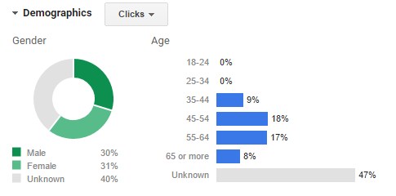
PPC Audience demographics
Audience under 35 removed from ad targeting.

Slide 10
Future initiatives
Add conversion tracking to improve lead funnel
Optimize landing page to capture lead information
Reduce bounce rates for paid ads

