Slide 1
Luxury big island SEO report
Feb 2017

Slide 2
Executive summary
Total sessions to the website decreased by 21% but organic traffic increased by 11% due to increase in total organic keywords for the site.

Slide 3
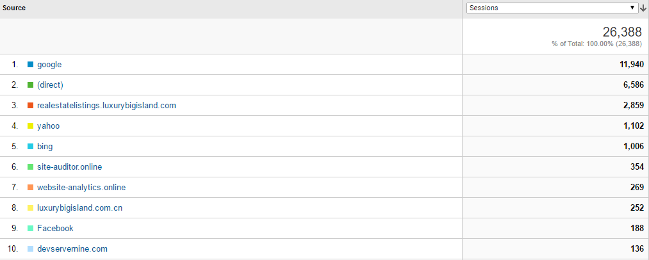
Top referrers (6 months)
70% of LBI traffic in the past 6 months came either through Google or through direct links.
The outsize share of Google traffic (45.2%) highlights the role of continuing SEO in generating traffic for the site.

Slide 4
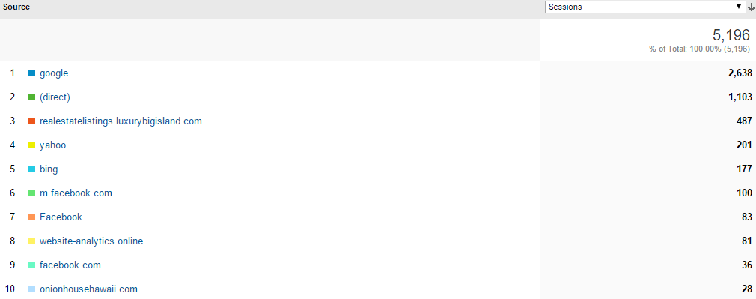
Top referrers (february)
February trends for referral traffic follows the general trend found in looking at data for the last 6 months – search engines and direct traffic are still the primary traffic referrers.

Slide 5
Top website referrers (30 days)
Source | Referrals
onionhousehawaii.com | 58
website-analytics.online | 42
uniquehomes.com | 33
huffingtonpost.com | 9
patch.com | 5
businessinsider.com | 4
prweb.com | 4
queensmarketplace.net | 4
hawaiiinfoguide.com | 3
military-technologies.net | 3

Slide 6
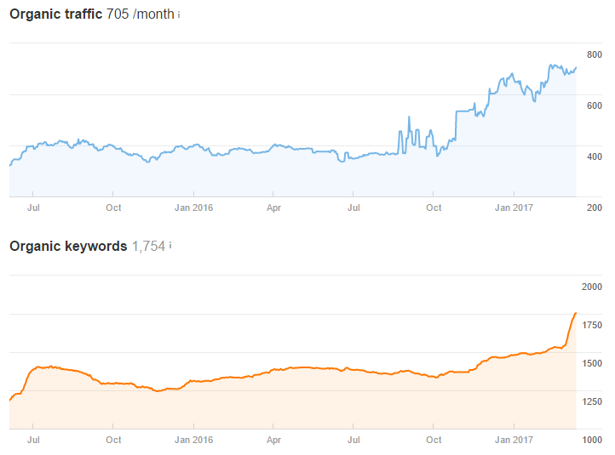

Organic traffic

Slide 7

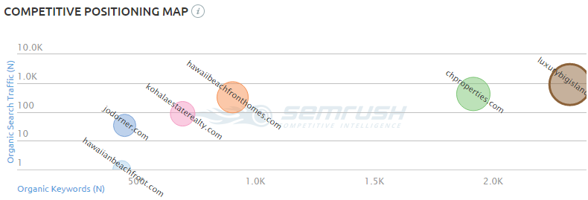

SEO Audit

Slide 8
Top Referring content
Referring Page Title | Referring Page URL | Link Anchor | Domain Rating | URL Rating | SP (desc)
Is This Sprawling $33M Hawaiian Estate the Most Expensive Big Island Has Seen? | http://www.justluxe.com/lifestyle/house-and-home/feature-1959144.php | Luxury Big Island by Harold Clark | 60 | 14 | 26
Dell’s Mitzvah Rescued Buyout as JPMorgan’s Lee Warned of Perils - Bloomberg | http://www.bloomberg.com/news/articles/2013-10-29/dell-s-mitzvah-rescued-buyout-as-jpmorgan-s-lee-warned-of-perils | Harold Clarke | 78 | 22 | 6
The Onion House, Hawaii... Vacation in a Work of Art - Vacation in a Work of Art! The Onion House, a landmark of Organic Architecture, was built for the McCormick Spice family. | http://www.onionhousehawaii.com/ | For Sale | 42 | 25 | 4
This $33 million Hawaiian estate looks like my dream home | http://luxatic.com/this-33-million-hawaiian-estate-looks-like-my-dream-home/ | Harold Clark from Luxury Big Island | 53 | 9 | 3
Architectural Photography - Interiors Photography - Hospitality Photography - Austin Texas-Hawaii | Ethan Tweedie Photography | http://www.ethantweedie.com/blog/ | Harold Clarke’s website Luxury Big Island. | 45 | 17 | 2
Architectural Photography - Interiors Photography - Hospitality Photography - Austin Texas-Hawaii | Ethan Tweedie Photography | http://www.ethantweedie.com/blog/ | Mauna Kea Resort | 45 | 17 | 2
Luxury listing: Hualalai resort home in Hawaii | http://www.inman.com/2016/03/31/luxury-listing-hualalai-resort-home-hawaii/ | Luxury Big Island By Harold Clarke | 66 | 17 | 2
Harold Clarke - Real Estate Agent in Waikoloa, HI - Reviews | Zillow | http://www.zillow.com/profile/Harold-Clarke/ | Blog | 74 | 13 | 2
The Brutalist holiday: 6 concrete resorts for architecture enthusiasts - The Spaces | http://thespaces.com/2016/02/04/the-brutalist-holiday-6-concrete-resorts-for-architecture-enthusiasts/ | Big Island Luxury | 54 | 12 | 1
Which Island is Right For Your Hawaii Golf Vacation? - Golf Vacation Insider | http://www.golfvacationinsider.com/usa/islands-kawaii-golf-vacation-14905 |  | 49 | 10 | 1
The #Ultimate #Property for #Sale – #HualalaiResortHome | LuxeLore.com - Global Luxury Resources Portal | Home for Luxury Brands, Products, Services & discussions on luxury items | LuxeLore Global Home Page | | http://luxelore.com/luxe-living/the-ultimate-property-for-sale-hualalairesorthome/ | www.luxurybigisland.com | 40 | 6 | 1

Slide 9
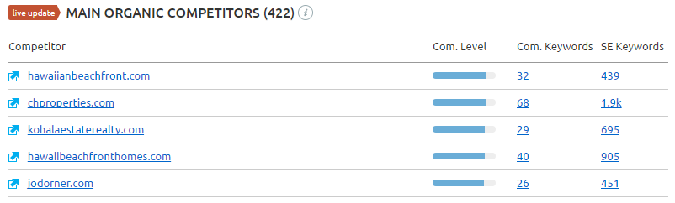
Main organic Competitors
Competition level below is based on the number of keywords common to each domain.

Slide 10
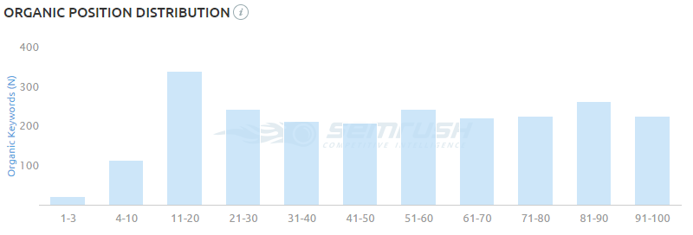
Organic position distribution
Good mix of keywords on different page positions. Over 100 keywords on the first search page (1-10).

Slide 11
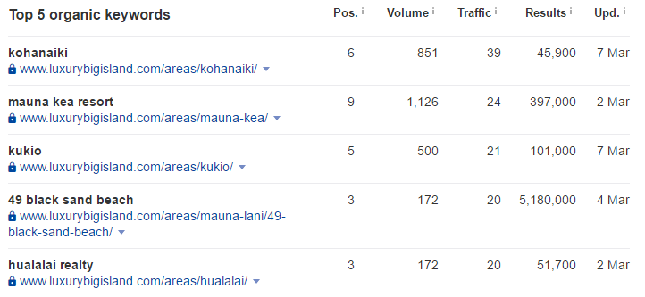
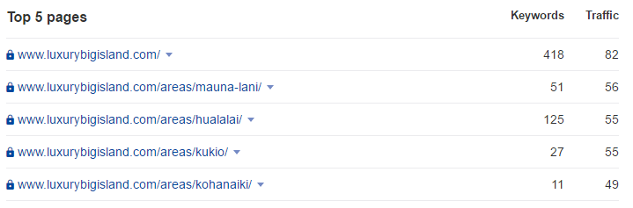
top organic Keywords and pages

Slide 12
Top movers
Keyword | Previous Position | Position Movement | Current Position | Keyword
mana lani hawaii | - | new | 10 | mana lani hawaii
big island land for sale | 15 | up | 10 | big island land for sale
ocean front property | - | new | 18 | ocean front property
mauna lai hawaii | - | new | 14 | mauna lai hawaii
pacific business news | 42 | up | 15 | pacific business news
mani lani hawaii | 17 | up | 14 | mani lani hawaii
mani lani hawaii | 16 | up | 15 | mani lani hawaii
big island real estate | - | new | 16 | big island real estate
black sand beach | 40 | up | 28 | black sand beach
big island real estate | 17 | up | 15 | big island real estate
beachfront property | 78 | up | 24 | beachfront property
hualalai homes | 8 | up | 3 | hualalai homes
waikoloa resort | 27 | up | 17 | waikoloa resort
real estate on the big island hawaii | 31 | up | 16 | real estate on the big island hawaii
farm land for sale hawaii | - | new | 17 | farm land for sale hawaii

Slide 13

Sources

