Slide 1
Luxurybigisland.com PPC Review
April 2017

Slide 2
Impressions and clicks
Bid adjustment for Hawaii searches
Bid adjustment for Hawaii searches relaxed

Slide 3
Impressions and clicks activity
Impressions per day dropped after bid adjustment for Hawaii searches were increased
1
Slight decrease in total clicks after the bid adjustments were implemented but at a lower rate than impression drop
2
Increased competition for Hualalai keywords. KW cost to rank has increased by a significant margin
3

Slide 4
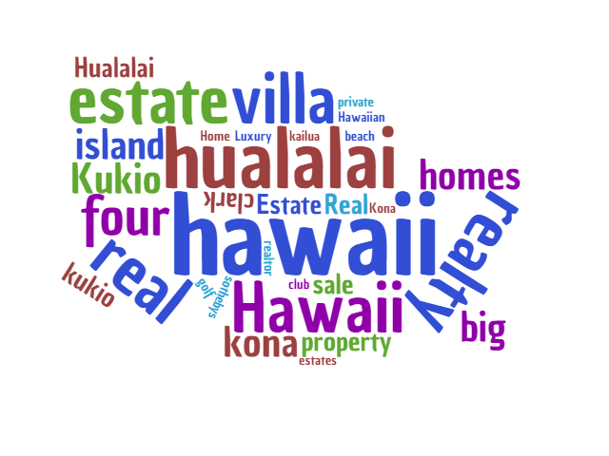
Keywords
Main keywords has not significantly changed
Additional keywords were added in but projected traffic is too low to activate the search keywords

Slide 5
Top performing keywords
Keyword | Clicks | Impressions | CTR
[luxury hawaii homes] | 1 | 2 | 50.00%
"Kukio homes for sale" | 3 | 18 | 16.67%
[luxury big island] | 3 | 22 | 13.64%
Hawaiian +Luxury +Home | 7 | 58 | 12.07%
"luxury big island" | 3 | 29 | 10.34%
luxury real estate +kona | 18 | 187 | 9.63%
[hawaii luxury real estate] | 2 | 25 | 8.00%
luxury property +Hawaii | 13 | 174 | 7.47%
luxury real estate +Hawaii | 20 | 284 | 7.04%
clark hawaii +real +estate | 30 | 468 | 6.41%

Slide 6
Top performing keywords analysis
Keyword cost has increased
1
Search partners are taking a bid slice of impressions but clicks are low
3
Good search position for keywords with high volume

Slide 7
Clicks by state
94% clicks are coming from three locations: Hawaii, California or Washington.
Bid adjustments decreased the number of clicks from Hawaii but has not shown significant effect on the number of searches from other regions

Slide 8
Ad position
Ad group | Impressions | Clicks | CTR | Average Position
Kukio | 1039 | 43 | 4.14% | 1.5
Hualalai | 2140 | 21 | 0.98% | 4.2
Search | 25691 | 510 | 2.14% | 4.1
CTR% improved for all ad groups except Hualalai. Ad position marginally improved overall but placement for Google is still within the top 4. Keyword cost for Hualalai increased significantly.
Search Ad group
Impressions down 50% but clicks only down by 20%.
Hualalai Ad group
Ads and clicks has decreased by 33% due to increased keyword costs
Kukio Ad group
Clicks has increased 169%
Impressions has increased by 109%
Ad CTR increased by 178%
Ad position on search partners is bring totals down
CTR increased by 67%

Slide 9
Ad position
Ad position has generally improved overall. Actual ad position appears lower than average numbers due to impressions from partner networks.
Spend on partner networks is negligible, but they are inflating impressions numbers

Slide 10
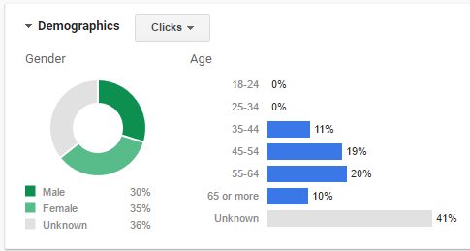
PPC Audience demographics
Click demographic essentially unchanged from March

Slide 11
Future initiatives
Continue to manage clicks from Hawaii through fine tuned bid adjustments
Move low performing keywords to separate campaign to capture occasional clicks but to avoid affecting quality score of existing campaigns
Turn on display campaigns
Remove ads from search partners

Slide 12
Facebook campaign

Slide 13

April campaigns
Campaign Details:
Total Spend: $165.77
Active: April 13 – 22
Engagements: 236
Total Reach: 2310
Cost per Engagement: $0.7
Placement: Facebook only

Slide 14
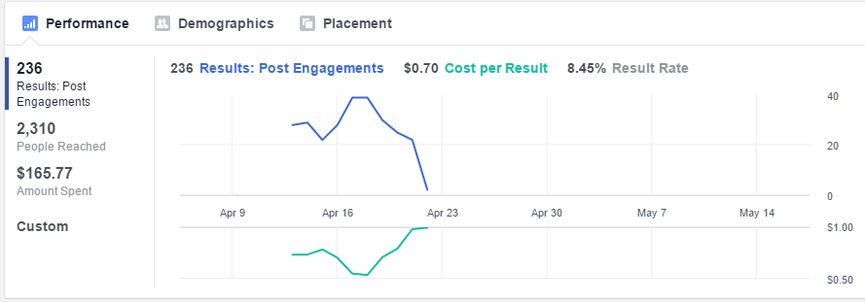
Campaign performance
Good results for this campaign, cost per engagement is low and 10% of the people reached performed and action.
Observable drop in performance at the latter part of the campaign but this may be due to seasonal effects due to day of week.

Slide 15
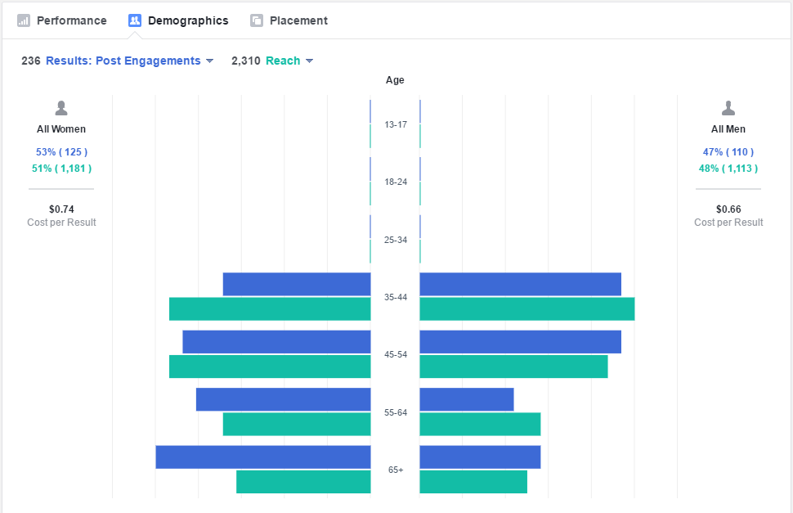
Reach Demographics
Men are slightly more inclined to engage in the 35-44 and 45-54 bracket but women are more dominant in numbers and engagement in the 55-64 and 65+ brackets.

Slide 16
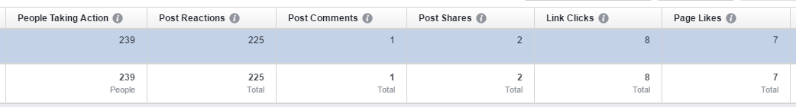
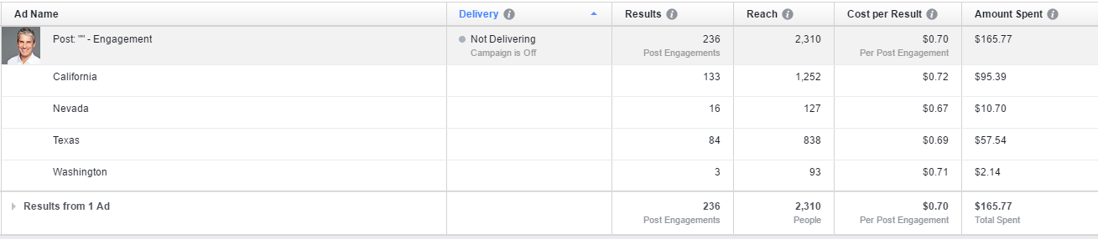
Campaign details

Slide 17
May campaigns
Good Neighborhood campaign is due to run on May
Other Facebook initiatives on queue to support PR campaigns
Recuts of existing videos to optimize those creatives to platform

