Slide 1
Luxury big island SEO report
Apr 2017

Slide 2
Executive summary
Total sessions to the website decreased by 12%.
Total organic traffic increased by 26% and ranking organic keywords increased by 27%.

Slide 3
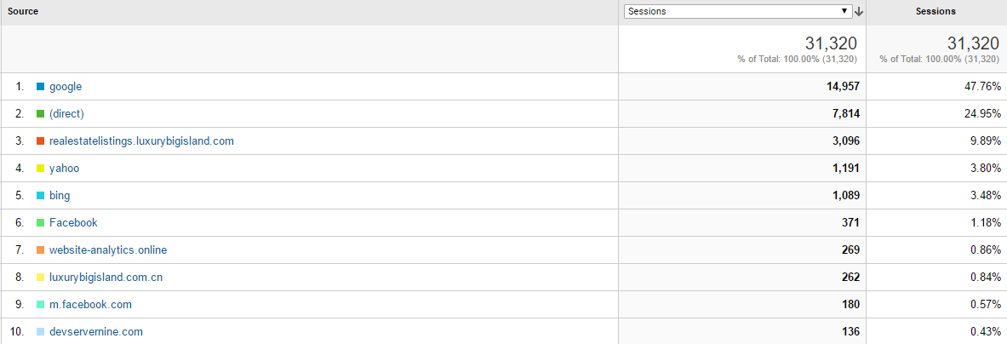
Top referrers (6 months)
72% of LBI traffic in the past 6 months came either through Google or through direct links.
Facebook traffic continues to increase due to higher share in 2017

Slide 4
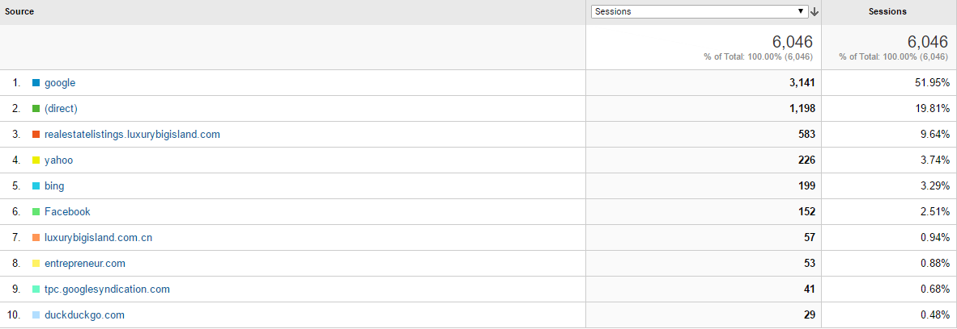
Top referrers (april)
Referral trends does not deviate from generally established patterns. Google, direct traffic and internal referrals still make up the bulk of the traffic.
However, direct traffic has dropped 10%. Yahoo and Bing and seen increased gains while Facebook share of the traffic has almost doubled compared to the previous month.
Entrepreneur.com has contributed to a share of traffic this month.

Slide 5
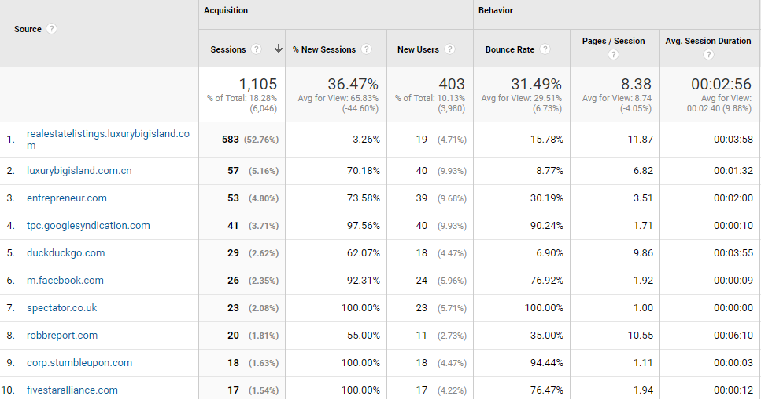
Top website referrers (30 days)

Slide 6
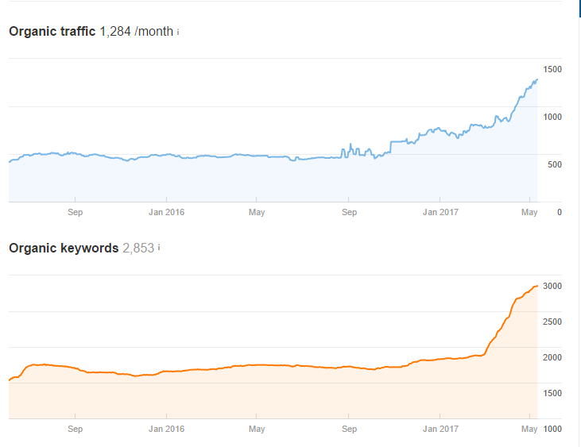
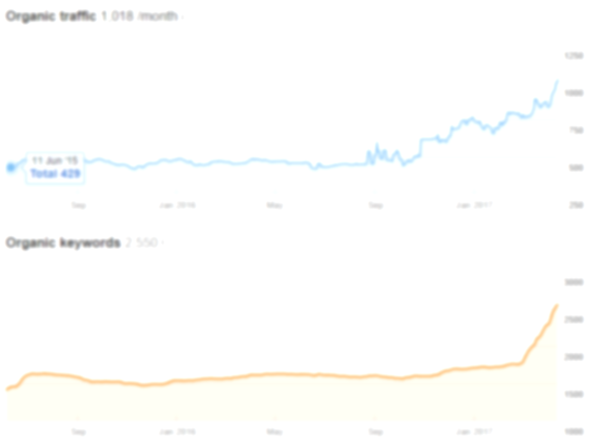

Organic traffic
Organic traffic/month continues to increase. Traffic in this period increased by 26% compared to the previous month.
Increase in organic traffic if partially driven by the increase in ranking keywords (27%).

Slide 7
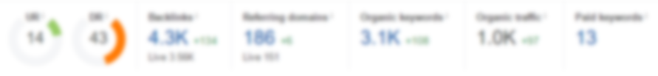

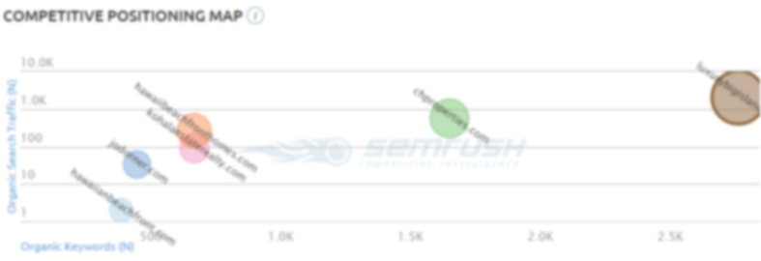
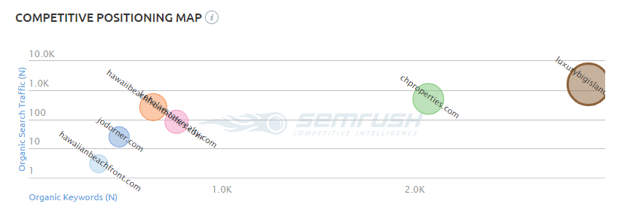

SEO Audit

Slide 8
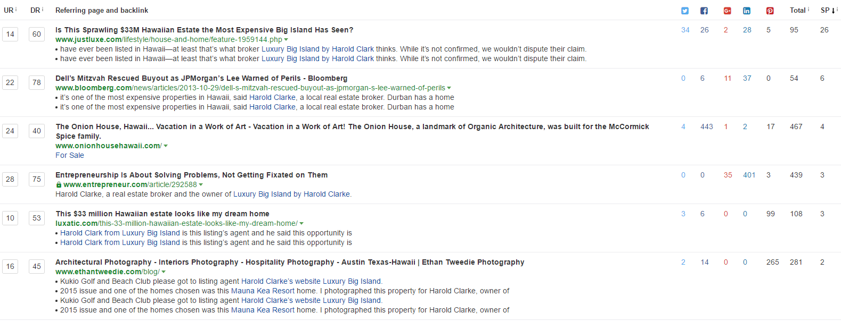
Top Referring content
Entrepreneur is a new addition to the list and has a high LinkedIn score

Slide 9
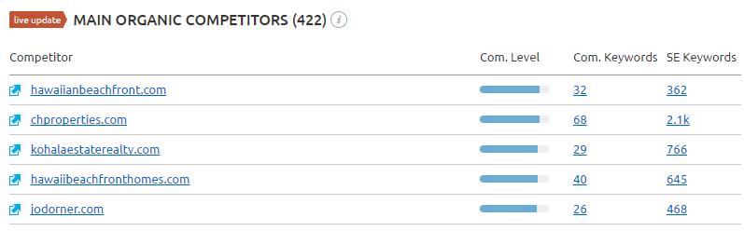
Main organic Competitors
KW overlap with competitors has not changed in the past month. chproperties is the main competitor when it comes to keyword overlap and number of keywords.

Slide 10
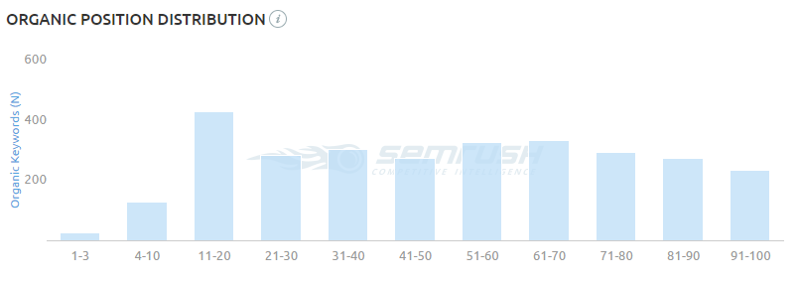
Organic position distribution
Good mix of keywords on different page positions. Over 100 keywords on the first search page (1-10). Overall distribution has not changed compared to the previous month.

Slide 11
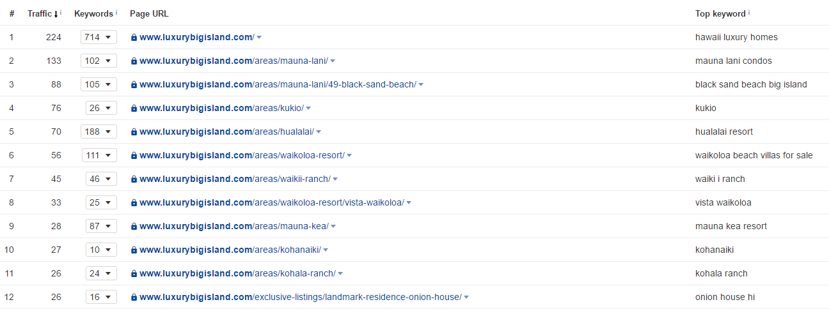
top organic Keywords and pages

Slide 12

Top movers
Keyword | Previous Position | Position Movement | Current Position | URL
black sand beach hawaii | 17 | up | 15 | /areas/mauna-lani/49-black-sand-beach/
waiki | 10 | up | 9 | /areas/waikii-ranch/
waimea | 34 | up | 30 | /areas/waimea/
waikoloa | 23 | up | 21 | /areas/waikoloa-resort/
kolea at waikoloa beach resort | 16 | down | 20 | /areas/waikoloa-resort/kolea/
hawaii luxury real estate | 6 | down | 10 | /
fairways at mauna lani | 9 | up | 5 | /areas/mauna-lani/fairways-at-mauna-lani/
real estate big island hawaii | 13 | lost | - | /areas/waimea/
kamilo beach | 19 | up | 11 | /areas/mauna-lani/ka-milo/
big island news now | 42 | up | 16 | /news/
mauna kea villas | 7 | up | 3 | /areas/mauna-kea/villas-at-mauna-kea/
big island real estate | 14 | up | 11 | /
kukio | 5 | up | 3 | /areas/kukio/
waikoloa fairway villas | 20 | up | 11 | /areas/waikoloa-resort/fairway-villas-at-waikoloa/
waimea real estate | 13 | up | 10 | /areas/waimea/

Slide 13

Sources

