Slide 1
LUXURYBIGISLAND.COM Social Media Report
April 1, 2017 – April 30 2017

Slide 2
Total Sessions by Source

Slide 3
Traffic from Social Sources

Slide 4
Social Media Traffic by Source
Facebook Traffic value is high but needs to be verified for conversions

Slide 5
Top Social Media Sources

Slide 6
Competitor Stats

Slide 7
Social Media Traffic Summary
Direct traffic from social media currently accounts for 1.44% of total traffic.
Facebook is the top social media sites pushing traffic to the luxurybigisland.com website
Facebook traffic has the highest pages/session.
Pinterest have the highest average session duration.

Slide 8
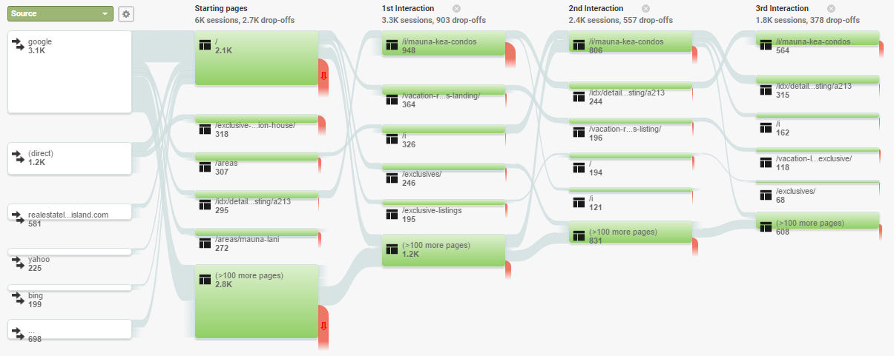
User Flow by Source

Slide 9
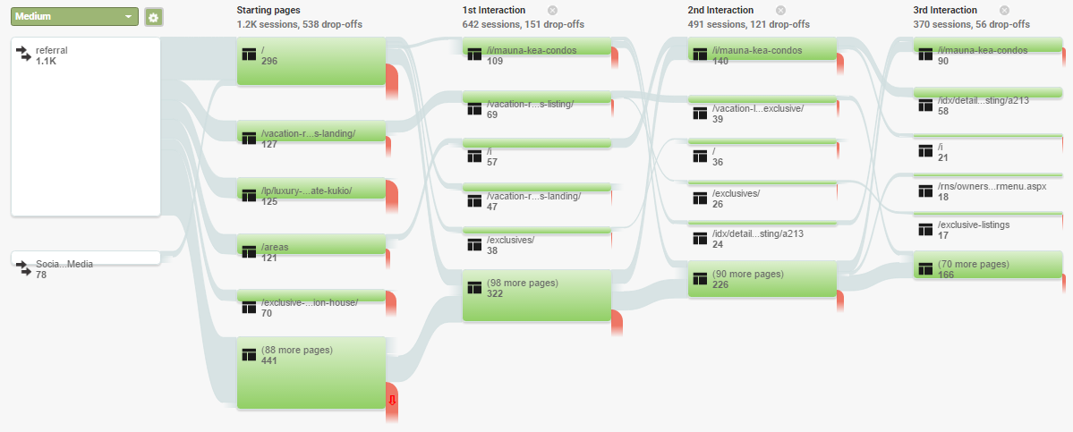
User Flow by Medium

Slide 10
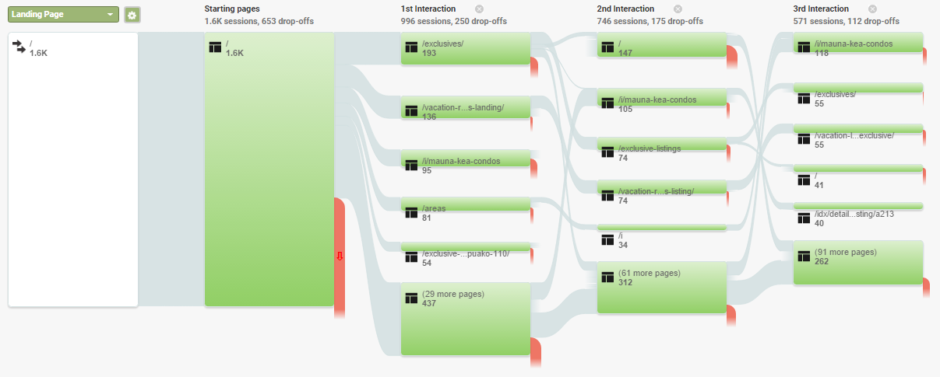
User Flow by Page (Main page)

Slide 11
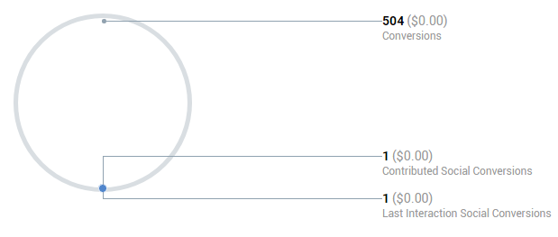
Social Conversions YTD
No value has been set per action, therefore benefit is $0.00

Slide 12
LinkedIn PageViews

Slide 13
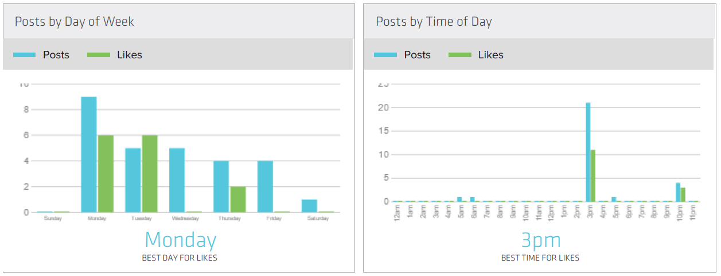
Twitter Stats (Best Day and Time)

Slide 14
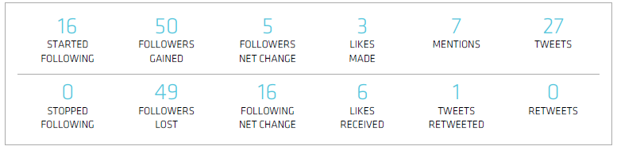
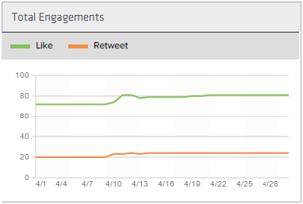
Twitter Stats

Slide 15
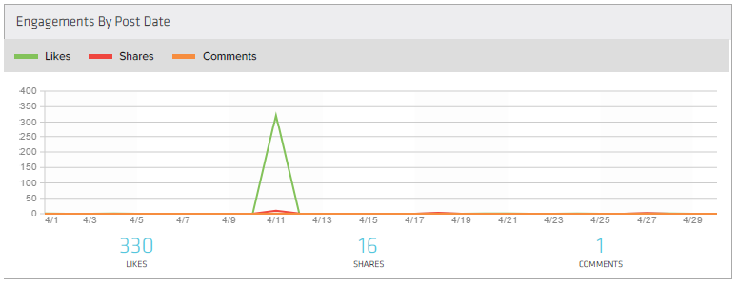
Facebook Stats (Engagement)

Slide 16
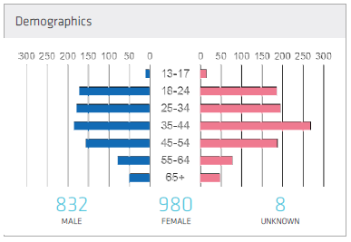
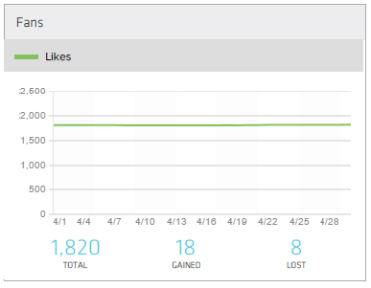
Facebook Stats (Audience)

Slide 17
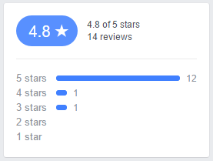
Facebook Reviews

