Slide 1
LUXURYBIGISLAND.COM Social Media Report
April 1, 2017 – April 30 2017

Slide 2
Total Sessions by Source

Slide 3
Traffic from Social Sources

Slide 4
Social Media Traffic by Source
Facebook Traffic value is high but needs to be verified for conversions

Slide 5
Top Social Media Sources

Slide 6
Competitor Stats

Slide 7
Social Media Traffic Summary
Direct traffic from social media currently accounts for 1.44% of total traffic.
Facebook is the top social media sites pushing traffic to the luxurybigisland.com website
Facebook traffic has the highest pages/session.
Pinterest have the highest average session duration.

Slide 8
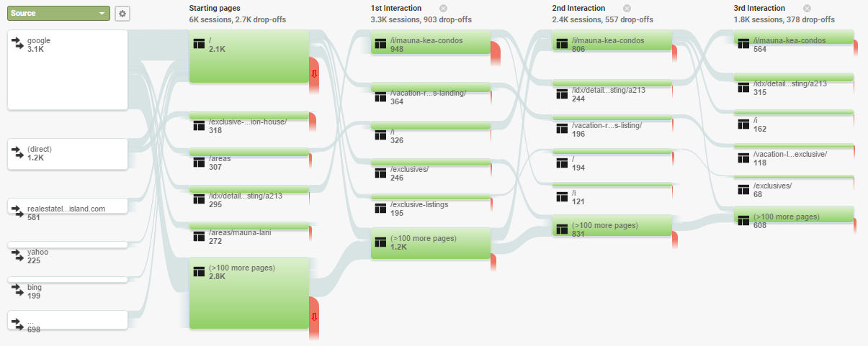
User Flow by Source

Slide 9
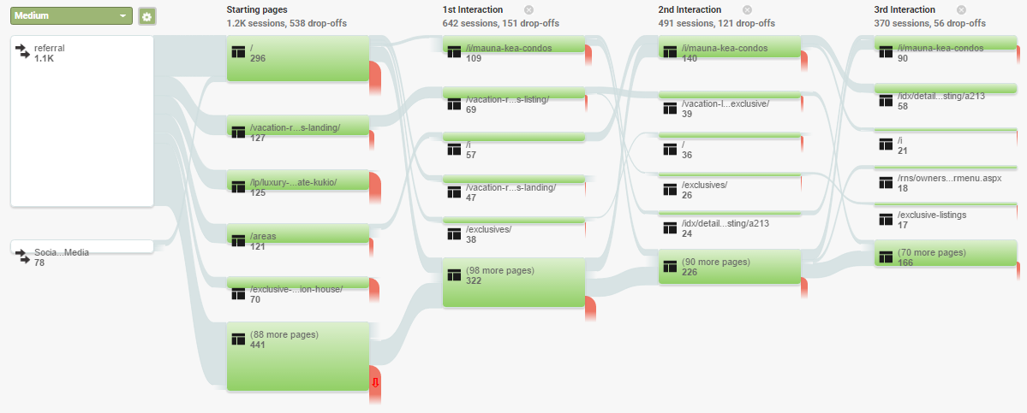
User Flow by Medium

Slide 10
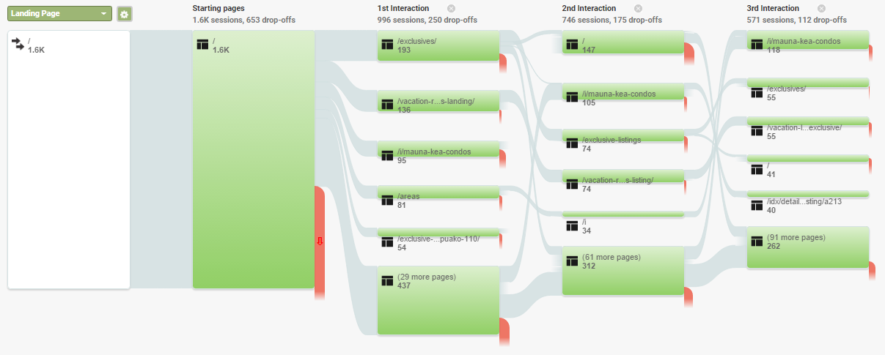
User Flow by Page (Main page)

Slide 11
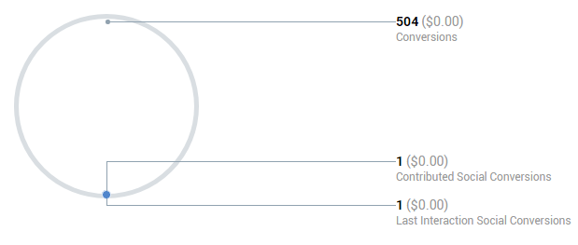
Social Conversions YTD
No value has been set per action, therefore benefit is $0.00

Slide 12
LinkedIn PageViews

Slide 13
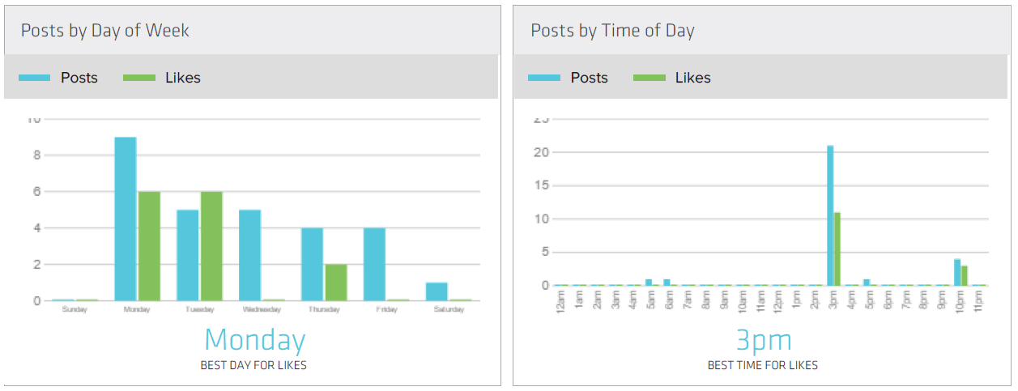
Twitter Stats (Best Day and Time)

Slide 14
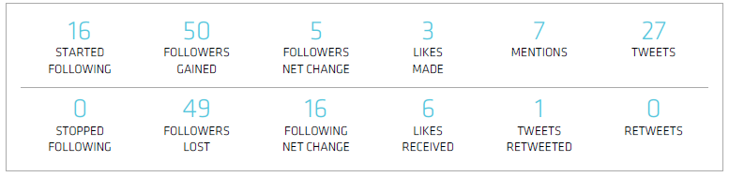
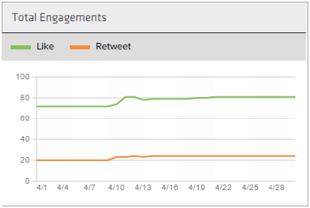
Twitter Stats

Slide 15
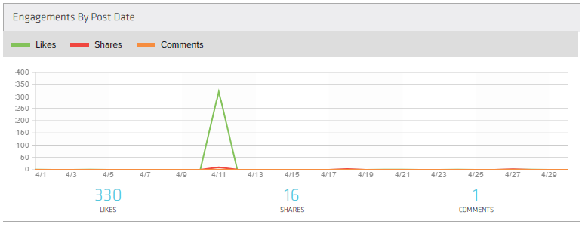
Facebook Stats (Engagement)

Slide 16
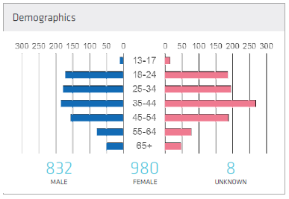
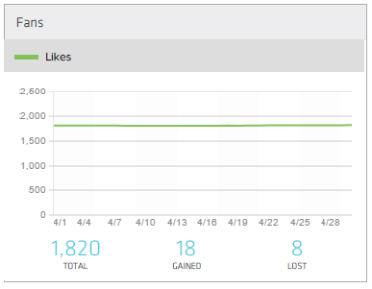
Facebook Stats (Audience)

Slide 17
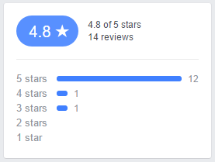
Facebook Reviews

Slide 18
Video Stats
TITLE | YOUTUBE (HC) VIEWS | YOUTUBE (LBI) VIEWS | VIMEO (HC) VIEWS
Hawaii Real Estate Finds A Thriving Market In The Chinese | 31 | 11 | 0
Hawaii Big Island Community: A Lifestyle not seen anywhere else in the world! | 14 | 8 | 1
Hawaii Big Island Community: Enjoy a community with like minded people. | 2 | 2 | 1

